Slide 1
Funding, research, and training opportunities
Sarah K. Bruch

Slide 2
Agenda
Research opportunities
Funding opportunities
Training opportunities
Q & A

Slide 3
Research opportunities
One of most important aspects of graduate training!
Highly recommended that students take personal initiative to find and seek out research opportunities.
Learn how research process works in real life (moving from research interest/topic to RQ)
Gain practical skills and experience conducting research that are transferable to other projects (design, data collection and management, methods, substantive area knowledge)
Opportunity for building relationships w/ mentors w/in the field
Opportunity for publishing research

Slide 4
Research opportunities
Types of opportunities:
Research assistant positions on faculty or center-based research projects
Collaborative or mentored research opportunities through unpaid research assistantships
Course-based research projects and independent study courses
Internships – many for applied policy and community engaged research (semester long or summer programs)
Independent research – thesis, dissertation

Slide 5
Research opportunities
Questions about research opportunities?

Slide 6
funding opportunities: by stage
Predoctoral (early years of graduate school)
Funding the early career scholar and research interests, not a specific project
Doctoral (dissertation fellowships)
Identify different opportunities that could be applicable (different framings of project)
Many are not only financial awards but also have mentoring and PD components
Post-doctoral (post-graduation)
Vary widely from focus on own research to work on existing projects, and expectations for teaching or other responsibilities

Slide 7
funding opportunities: sources
Government research agencies: IES, NSF, NIH, NAS
Government departments and agencies: federal, state, and sometimes local
Professional associations (and sections/divisions within these)
Policy research organizations
Foundations
UD Graduate College, and cluster/topic-based initiatives

Slide 8
Preparing funding applications
National Academies Resources
Preparing a Successful Fellowship or Grant Application (link)
Writing a Fellowship Proposal or Statement of Purpose (link)
How to Win a Graduate Fellowship (link)
How to Prepare for Prestigious National Scholarships (link)
Social Science Research Council
On the Art of Writing Proposals (link)
American Education Research Association
Standards for Reporting on Empirical Social Science Research in AERA Publications (link)
National Science Foundation
Proposal and Award Policies and Procedures Guide (link)

Slide 9
funding opportunities: advice
Identify opportunities that you might want to pursue at different stages of graduate career
Consider opportunities that align with your career goals post-graduation
Discuss opportunities with advisors and mentors
Plan adequate time for preparing a polished application (multiple drafts and rounds of feedback)
Solicit feedback and letters of recommendation/support from advisors and mentors
Seek out access to successful applications from the same program/funder and/or experience of applying from previous applicants or other information available (webinars etc.)

Slide 10
funding opportunities
Questions about funding opportunities?

Slide 11
Training opportunities
Consider taking more research methods courses than are required for your degree, especially when you plan to use a particular method for a research project or paper.
Lots of options for research methods training with short courses and workshops.
Many are offered in summer months.
Many are specific to particular methods (quantitative, qualitative, mixed).
Important to find quality providers, typically university-based trainings better than private.

Slide 12
training opportunities
Questions about training opportunities?

Slide 13
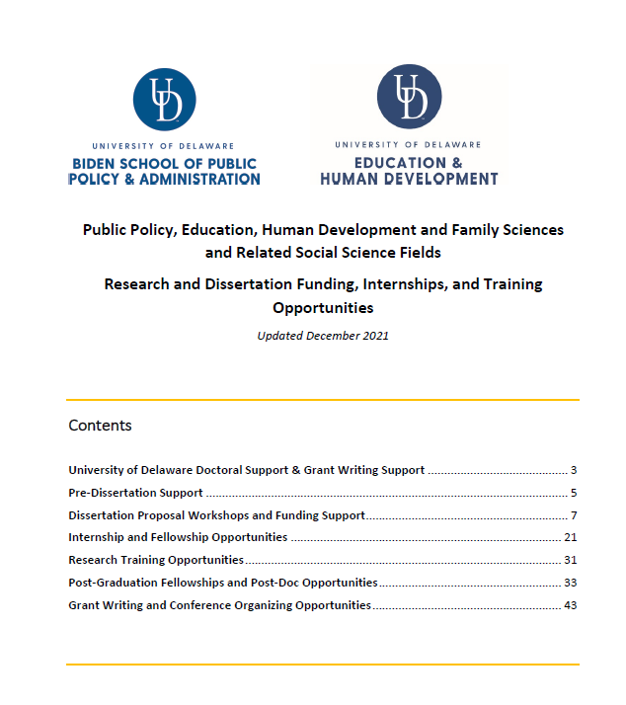
resources
Policy-Related Funding and Training Opportunities document
Slide decks for other PD sessions all available on Biden School website at: https://www.bidenschool.udel.edu/student-resources
Suggested Readings
Windsor and Kronsted 2022 “Grant Writing and the Hidden Curriculum: Mentoring and Collaborating Across Disciplines” PS: Political Science and Politics 55(2): 313-323.
Calarco 2020 “Chapter 6 Doing Research and Finding Funding” from A Field Guide to Grad School: Uncovering the Hidden Curriculum.

